Slide 1
WELCOME
7th African Islamic Finance Summit 2021
Technical Session - I:
Development of Islamic Banking and Finance in Africa
.
Presented by : Dr. Hima Mayaki Seyni

Slide 2
Islamic Finance & African Economy Development
TOPIC
Presented by: Dr. Hima Mayaki Seyni
International Development and Strategy-Director/Head of Islamic Finance Department LSMS, United Kingdom

Slide 3
contents
I. The Contemporary History of Islamic Finance
II. The Geographical Development of Islamic Finance
III. Africa
IV. The Functions of Islamic Banks
V. Other Components of the Islamic Finance Industry
VI. The Future of the Islamic Finance Industry
CONCLUSION

Slide 4
I. The Contemporary History of Islamic Finance
Founding Period 1963–1975 |  | Formative Period 1975–1990 |  | Development Period 1990–Now
1963 Mit Ghamr, Egypt, based on profit sharing and concepts of mutual credit union. |  | Formation of IsDB and commercial banks First attempts to turn conventional finance into an Islamic format, some new product development |  | Regulation and standardisation Islamic windows Increasing sophistication

Slide 5
I. The Contemporary History of Islamic Finance
Since the 1990s, Islamic finance has become increasingly sophisticated and Islamic financial products have developed to match almost every demand from capital markets, consumer banking and wealth management. During this period, the number of Islamic banks has expanded significantly around the world.

Slide 6
II. The Geographical Development of Islamic Finance
The Islamic financial industry has grown irrespective of any government support. Initially mainly limited to Middle Eastern countries, it expanded into Asia in the 1980s and into Europe from around 2002. Bahrain, Malaysia and the UK have played important roles in their respective regional Islamic finance markets and the developments in each of these jurisdictions have been beneficial to the global development of the industry.

Slide 7
III. Africa
Throughout the African countries, and currently in South Africa particularly, Islamic finance is gaining traction. In other countries, Islamic financial services are slowly being introduced

Slide 8
World bank data 2018

Slide 9
IV. The Functions of Islamic Banks
From an economic perspective, the functions of an Islamic bank are similar to those of the conventional financial industry and include the following
F1: Investment and investment management
F2: Generic banking services
In addition to these generic functions, Islamic banks carry out direct social services since they have an explicit responsibility for the development of their staff and their local communities. They also carry out indirect social services via the charities to which they have donated Zakat or other gifts.

Slide 10
IV. The Functions of Islamic Banks
Besides commercial banks, the Islamic finance industry also encompasses investment banks, investment funds, Takaful (insurance) companies and multilateral and development banks, such as the IsDB

Slide 11
V. Other Components of the Islamic Finance Industry
The Shariah-compliant equity markets; the market for Sukuk (Islamic capital market instrument); Islamic investment funds; Islamic insurance companies – Takaful; the Waqf properties (Islamic charitable trust); Zakat funds (funds constituted of charitable obligatory tax); Islamic microfinance

Slide 12
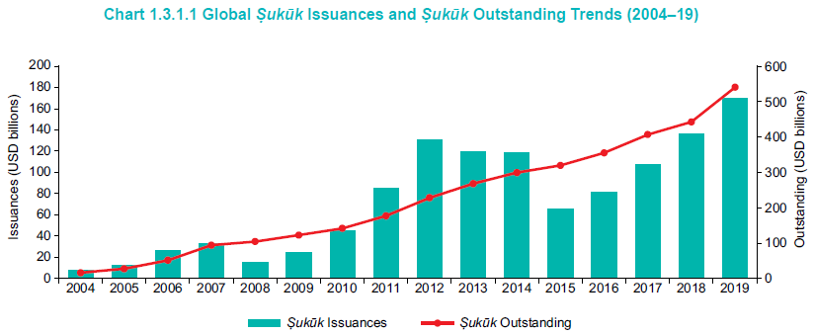

Slide 13
VI. The Future of the Islamic Finance Industry
the constraints and challenges on the development of the Islamic banking and finance industry
The Interaction of Shariah with Local Law and Regulation
In some countries, local regulations do not allow for financial instruments to be developed that conform perfectly with each requirement of Shariah and some concessions are made in order to meet local regulatory requirements. Although exceptionally approved, these products enable the Islamic finance industry to develop and may be used gradually to advocate change in local regulations in order to accommodate Shariah requirements. After all, something less than perfect is better than nothing at all.
In addition, once the instrument is accepted, efforts to improve the situation can be made. In Muslim countries, these differences are less likely to be encountered.

Slide 14
VI. The Future of the Islamic Finance Industry
The Constraints of Islamic Banking
Even though some of its instruments have been applied for centuries, the contemporary Islamic financial services industry is relatively young and is still developing new Shariah-compliant ways to provide a balanced, full offering of financial products and services. The ways in which Shariah-compliant products are structured vary by region, within regions, and by school of jurisprudence.
.

Slide 15
THANK YOU
FOR YOUR ATTENTION
BARAKALAFEEK

